Slide 1
Neural Networks: Foundations to Generative AI
Course Logistics and Introduction

Slide 2

Today’s Agenda
1. COURSE LOGISTICS
Website, schedule, grading and evaluation criteria.
Course textbook, lecture format, etc.
2. INTERESTING USE CASES
Frivolous, academic, and practically useful.
A recent failure, and societal concerns.
3. QUICK INTRODUCTION
What is a neural network?
How does it work?

Slide 3








My Background
Pre-2010
2010-2013
2013-2021
2021-Today

Slide 4
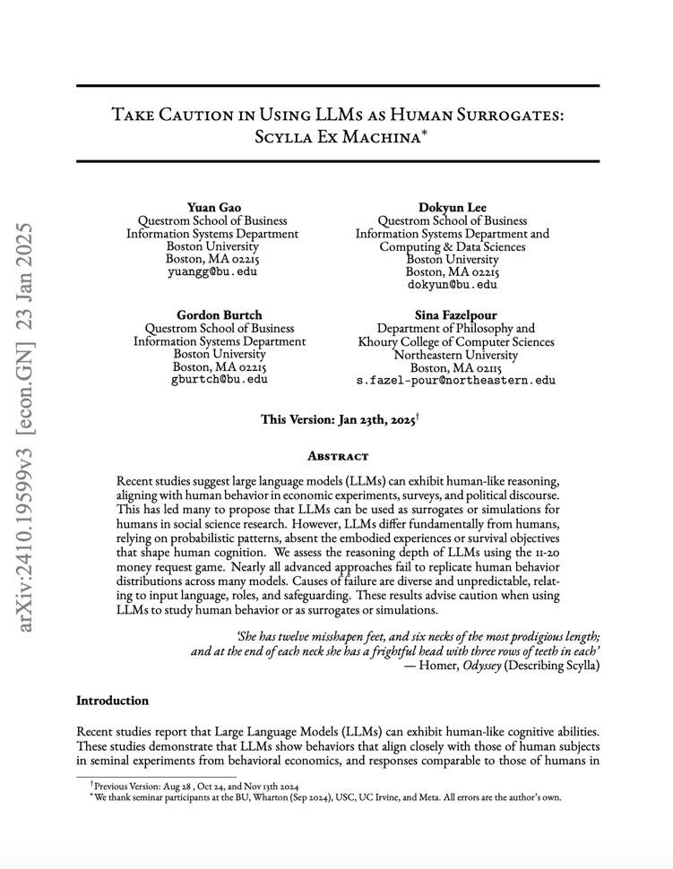
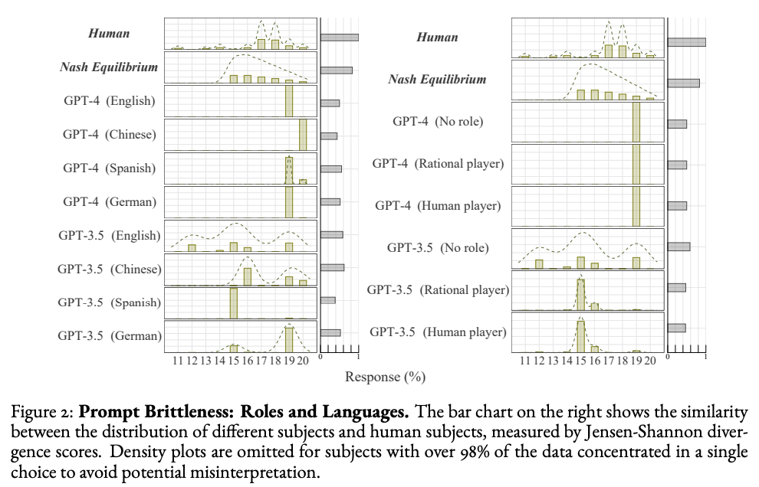
My Research

Slide 5
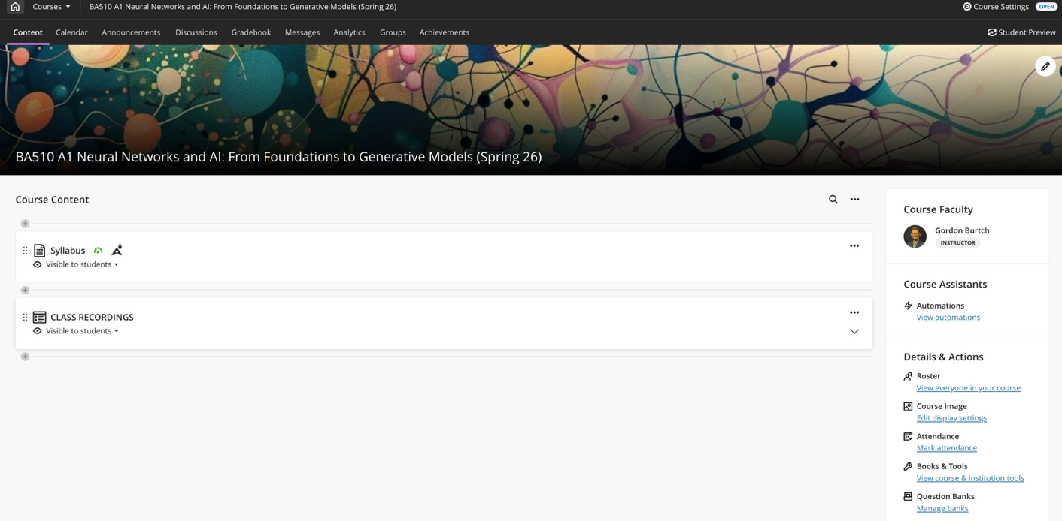

Course Materials
COURSE WEBSITE
The course website is on Blackboard – please let me know if you cannot see the site!
You will submit all assignments and receive relevant course announcements via that site.
I will post lecture materials and in-class exercises / examples via the GitHub Repository linked on Blackboard.
GOOGLE COLAB
All homework and exercises in this course are to be implemented in Python. You should work in Google Colab because I cannot provide technical support if you run into issues with your local instance. For your project and individual assignment, you’ll need to submit the .ipynb files that you produce in Colab.

Slide 6
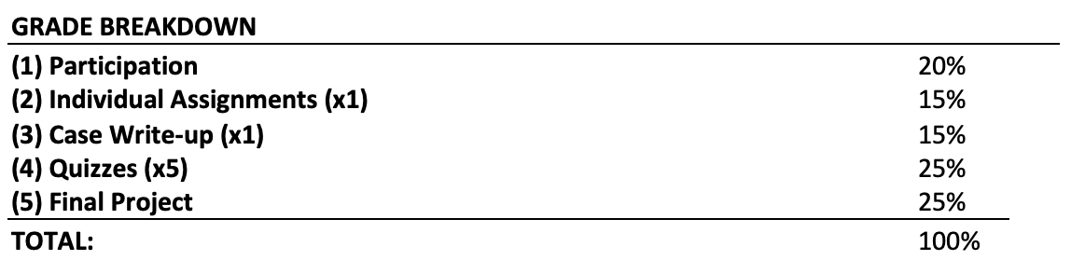
Grading and Evaluation
PARTICIPATION / ATTENDANCE
Regular attendance and participation will be worth 20% of your final grade.
INDIVIDUAL ASSIGNMENTS
One individual assignment worth 15% of your final grade
Due by 11:59pm on the date indicated in the course schedule – submit your Jupyter (Colab) Notebook file via Blackboard (submit the actual file with code, not a link to your notebook).
Late submissions will result in grade deductions, per the syllabus.
CASE WRITE-UP
We will discuss two HBS cases in class, and your submitted individual responses to case questions will be worth 15% of your final grade.
QUIZZES
We will have 5 in-class, timed, paper and pencil, closed book / closed note quizzes. collectively worth 25% of your final grade.
FINAL PROJECT
The final project (worth 25% of your final grade) is a hands-on implementation driven by you.
You will work in pairs or individually to implement a neural network-based predictive model that addresses a practical problem of interest to you! You need to identify and motivate the prediction problem (explain why it’s meaningful, who it would be of value to), and then implement your model.
Deliverables include a project proposal, a mandatory mid-point check-in meeting with me to ensure you are on track, submission of final code and slides, and a final presentation during the last week of class.

Slide 7

Course Textbook
Chollet, François. (2025). Deep Learning with Python (3rd Edition). Manning Publications Co. ISBN-13: 978-1633436589. https://deeplearningwithpython.io

Slide 8
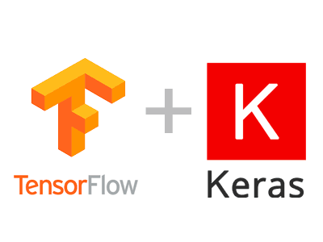
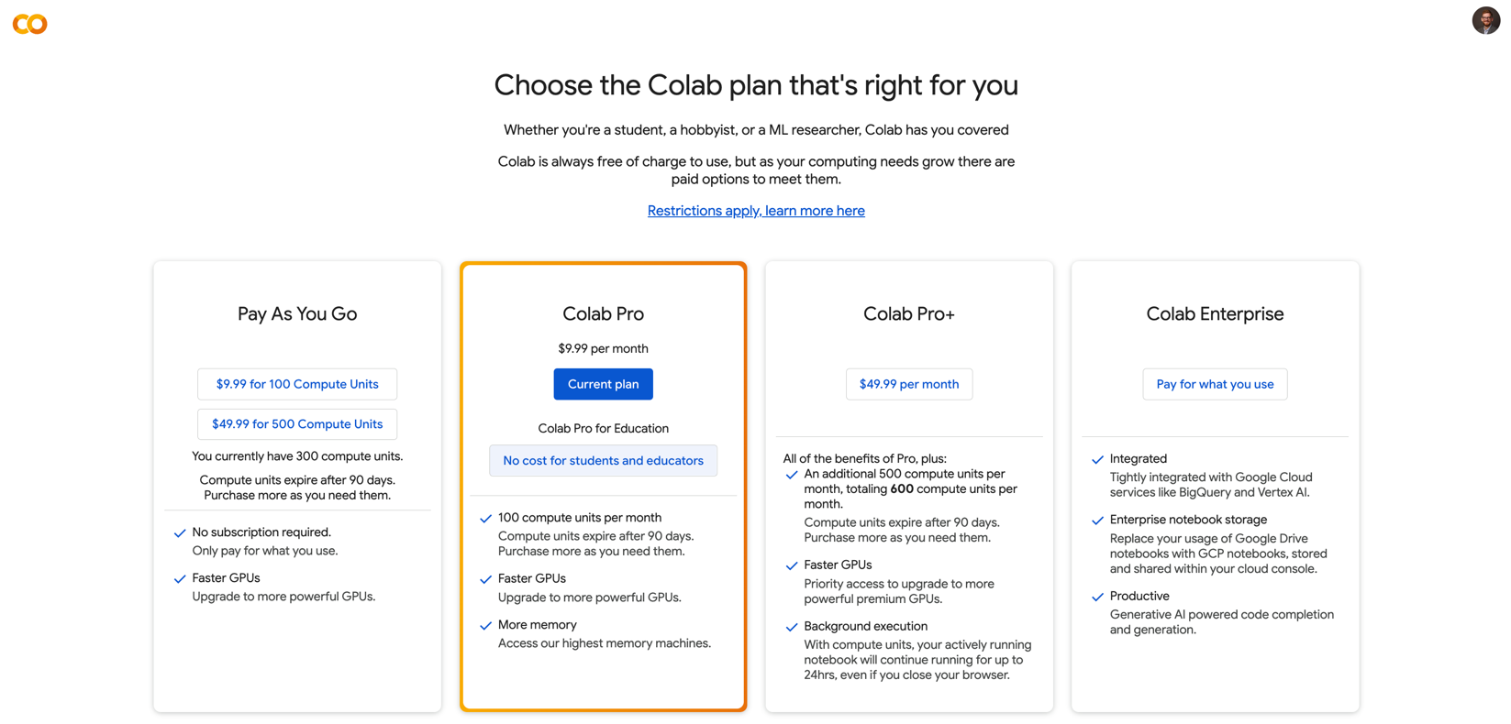

Required Software
You can access Google Colab at https://colab.research.google.com. You will want to use your BU Google account credentials!

Slide 9
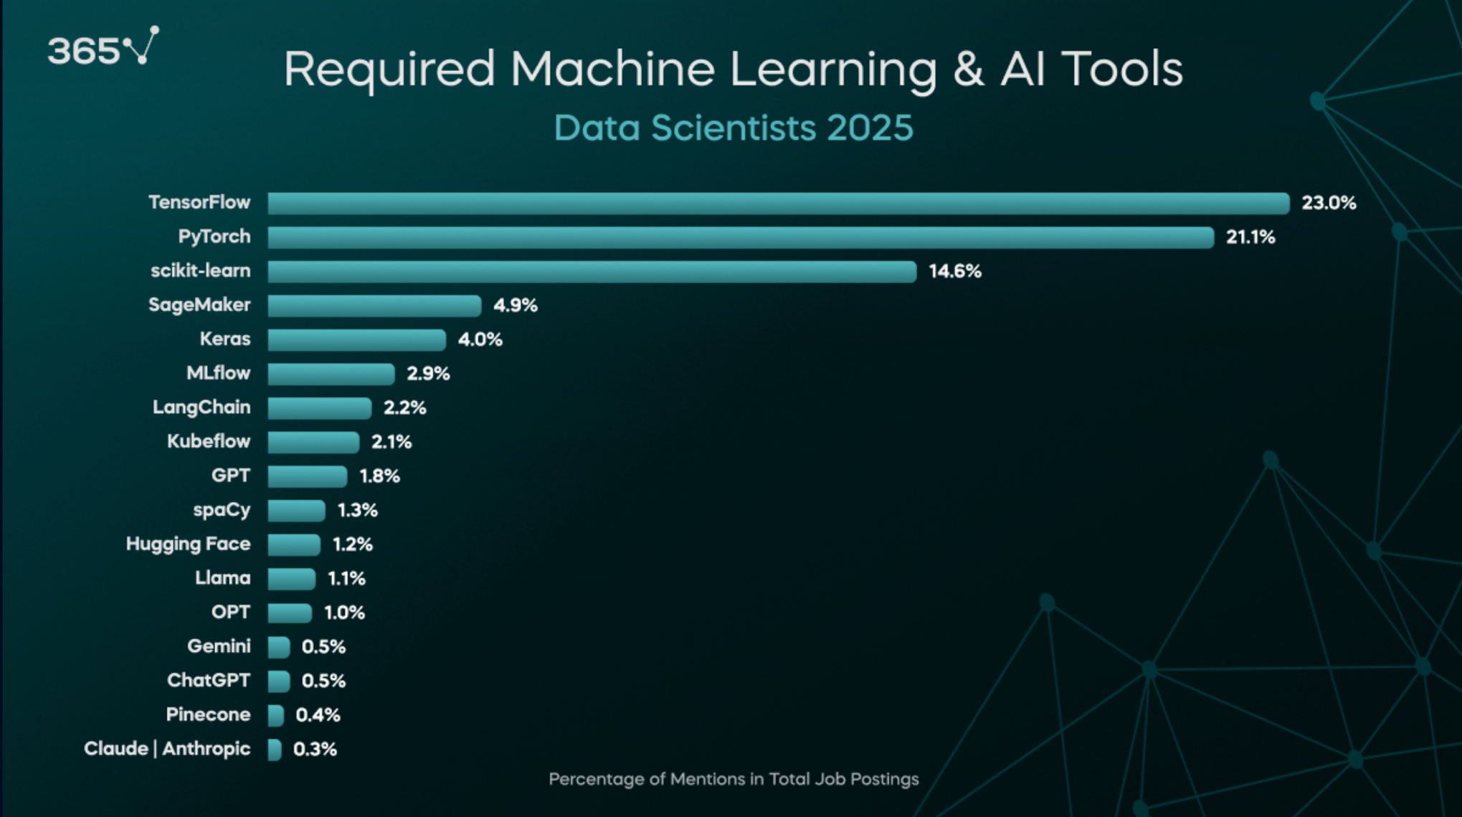
Why Keras?

Slide 10
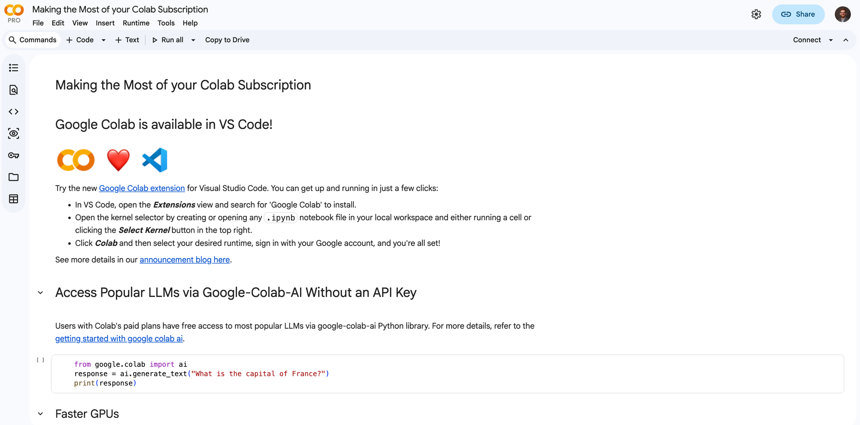
Google Colab

Slide 11
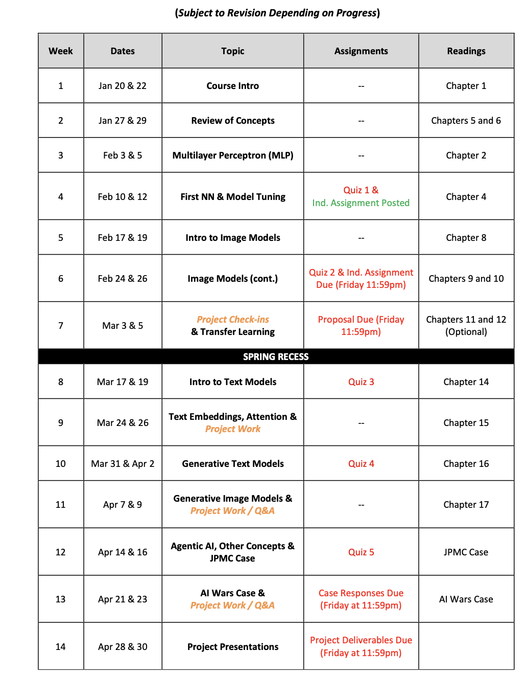
Course Timeline
AGENDA
We will start with the basic math concepts.
We will then get into neural networks for simple prediction problems with structured data (e.g., a spreadsheet).
Then, we will explore prediction tasks where inputs are unstructured data (e.g., images, audio, and/or text).
Finally, we will learn about generative neural networks and agentic models.
NOTE TIMING OF DELIVERABLES
First quiz will take place on 2/10.
Individual homework assignment will be due 2/27.
I will announce sign-ups for the first project proposal check-in meeting that will take place on 3/3.

Slide 12

Course
LECTURES
We will meet twice weekly for ~75 mins each session. The Tuesday session will typically focus on lecture / concepts / explanation.
HANDS-ON EXAMPLES
During the second session each week, we will walk through hands-on examples and demonstrations in Colab notebooks. I will provide these Colab Notebooks and data-sets (typically via GitHub).
You are encouraged to ask questions as we progress! Make it interactive!
Note that the quizzes, the individual assignment, and the exam will be based on the in-class material. I will not test you on things that were not discussed in class.

Slide 13
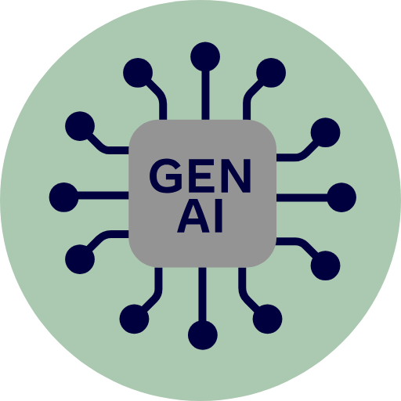
Policy
YOU CAN USE IT TO HELP YOU LEARN AND PERFORM BASIC TASKS
I expect you to use these tools, but the way you use them matters. Some valid use cases include i) implementing data munging tasks that you already understand based on past coursework, e.g., pre-processing text, or ii) automatic generation of code comments or documentation.
YOU SHOULD NOT GENERATE SOLUTIONS FROM SCRATCH
If you use these tools as a shortcut to avoid understanding the course material, you will not do well in the class. If I see you using functions and libraries that were not taught in the course (e.g., PyTorch), you may be asked to explain your code to me, verbally. If you are unable to explain what the code is doing, points will be deducted from your deliverable grade.

Slide 14

Pre-Survey: Your Interests & Background

Slide 15
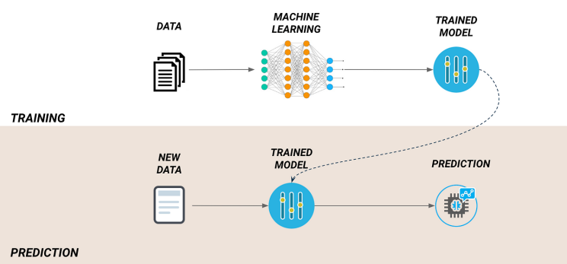
Supervised Learning
Notes:
Let’s ask ChatGPT!

Slide 16
So, What is ‘Deep’ (vs. Shallow) Learning?
https://chat.openai.com/chat
Notes:
Let’s ask ChatGPT!

Slide 17
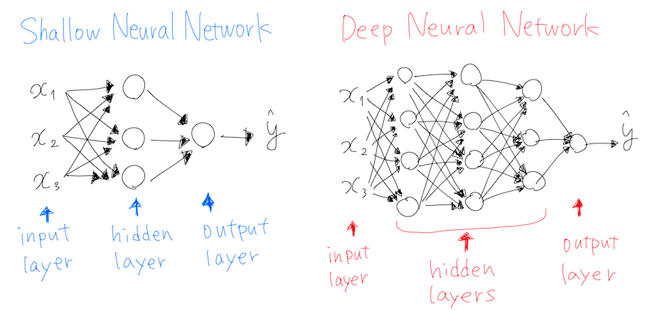
Notes:
Most other ML approaches are shallow (they map inputs to outputs in a single layer / transformation, or few layers). Deep here refers to the fact that there is a layered approach to transformation. 4 or more layers, generally, by which transformations feed into other transformations, enabling flexible representation of mappings.

Slide 18
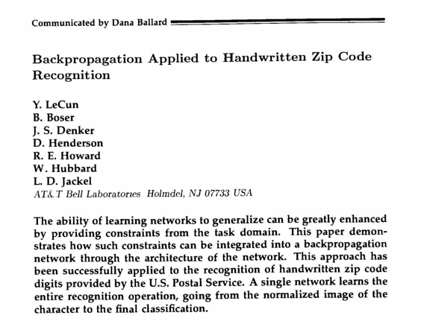
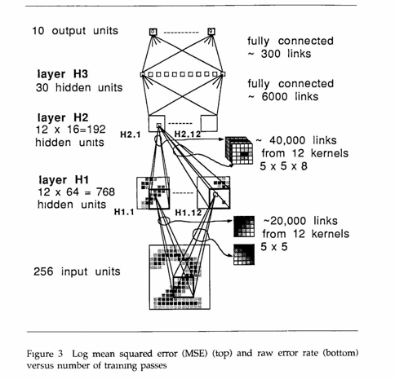
Where Deep Learning Started

Slide 19
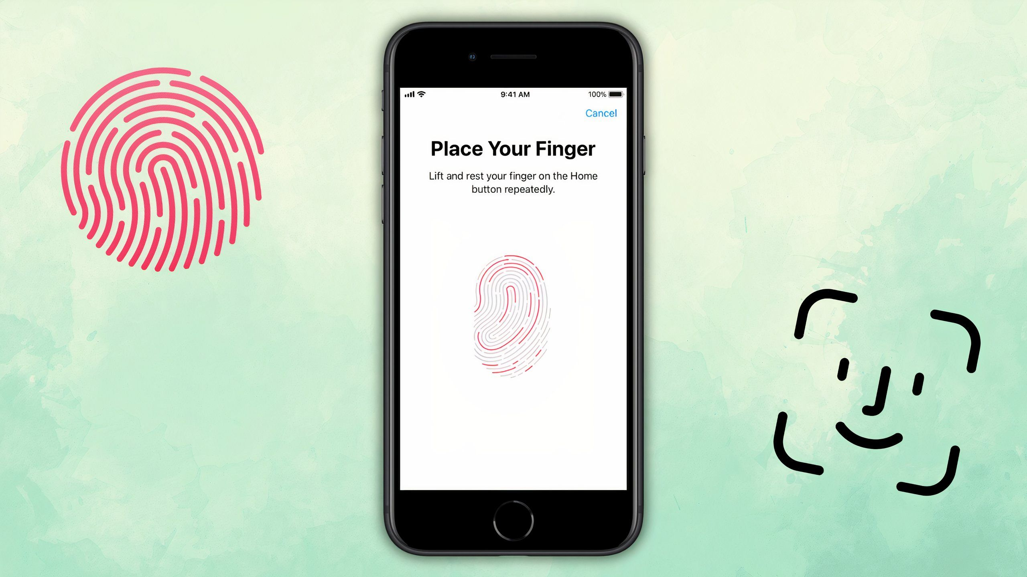
Modern Examples: Identity Verification
Notes:
Note that I don’t expect you to implement a neural network from scratch. This is just to give you an understanding of how they work.

Slide 20


Modern Examples: Fraud Detection
Notes:
https://www.neuro-id.com/wp-content/uploads/2024/08/NEURO_ONBOARDING.mp4

Slide 21

Modern Examples: Fake Review Detection
Notes:
https://www.neuro-id.com/wp-content/uploads/2024/08/NEURO_ONBOARDING.mp4

Slide 22

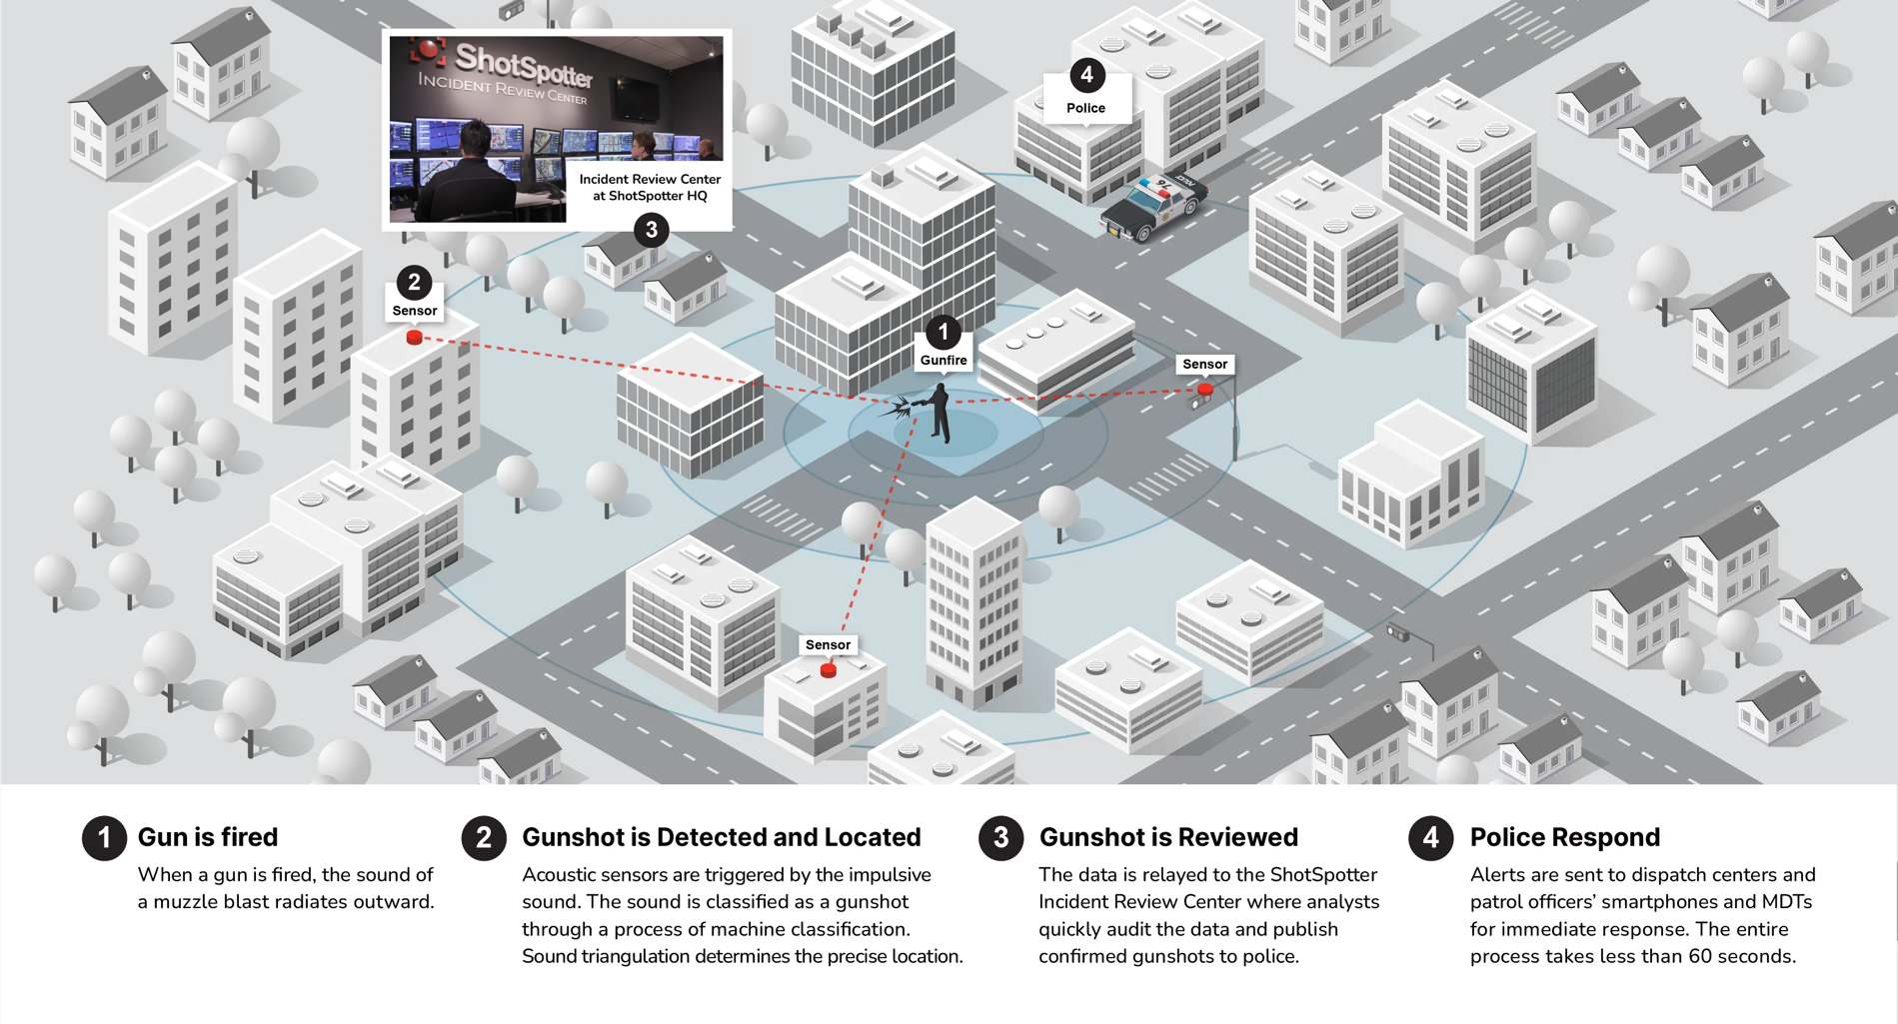
Modern Examples: Gunfire Detection

Slide 23

Modern Examples: Part Failure Prediction

Slide 24
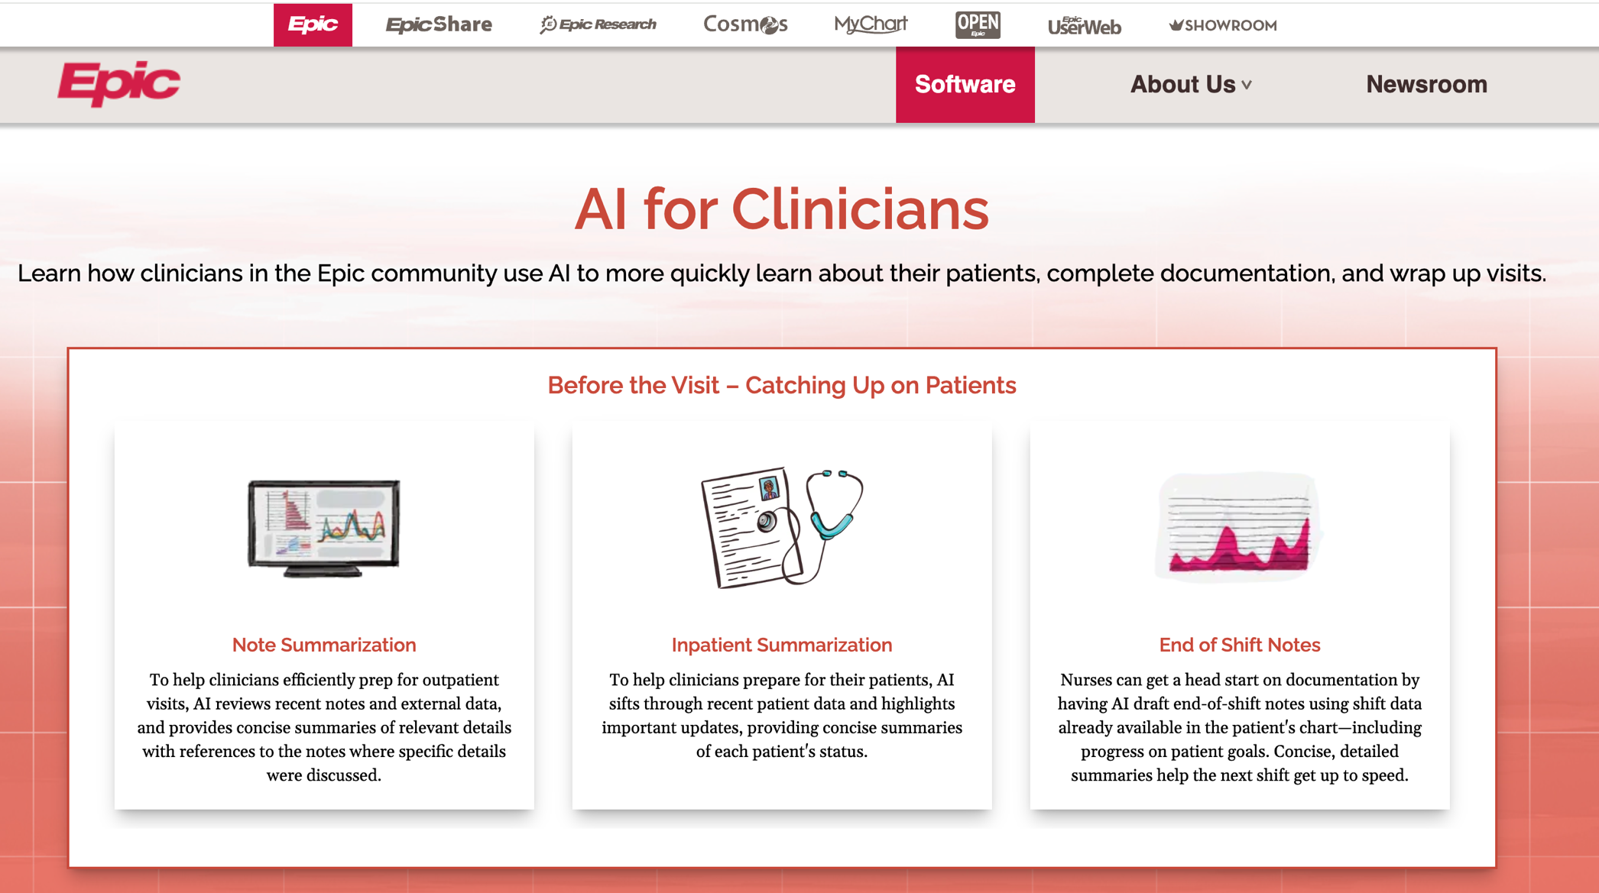
Modern Examples: Audio Transcription

Slide 25
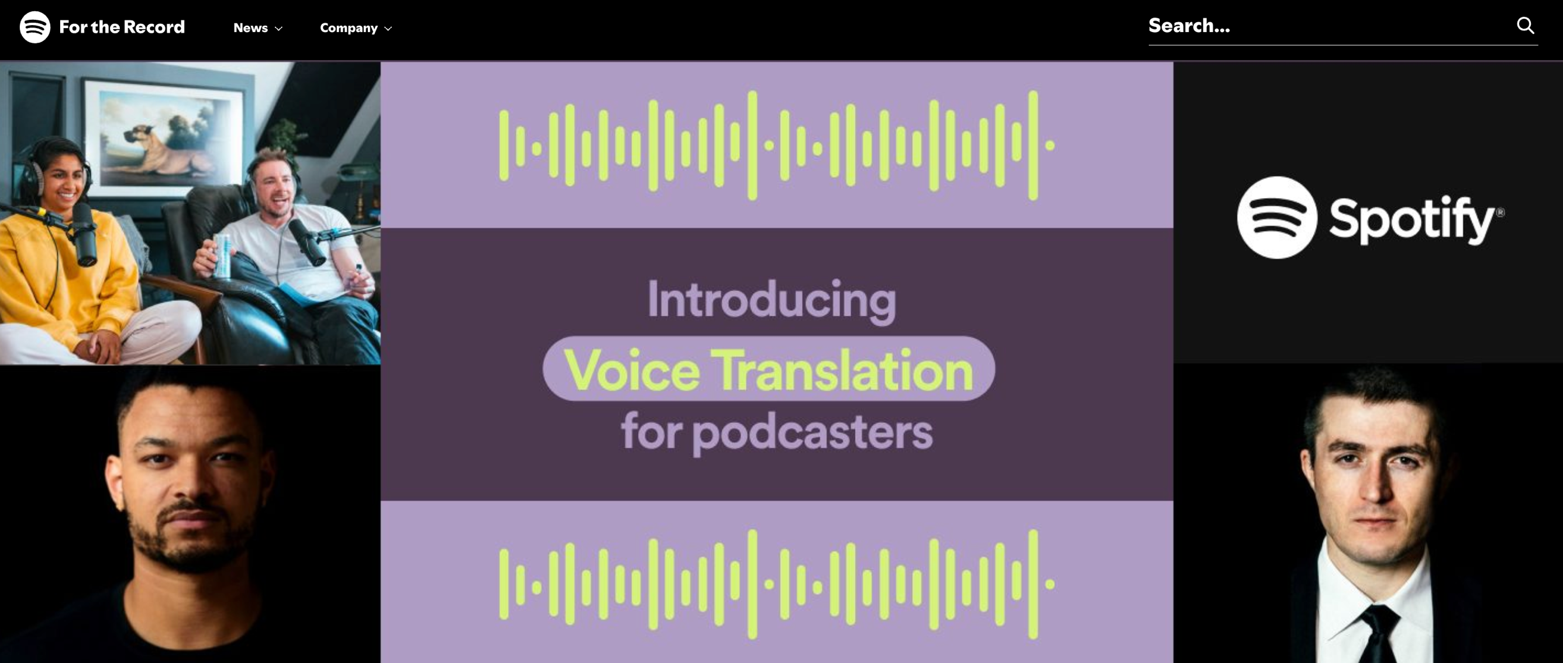
Audio Translation

Slide 26
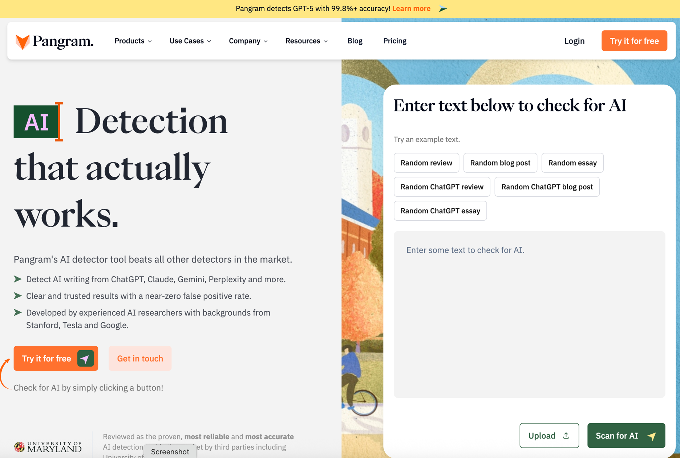
Modern Examples: AI Text Detector

Slide 27
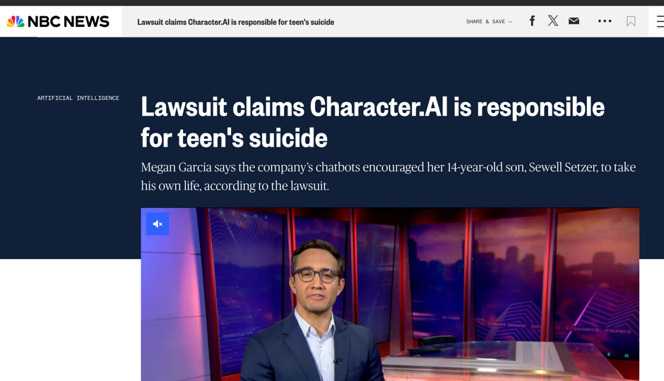

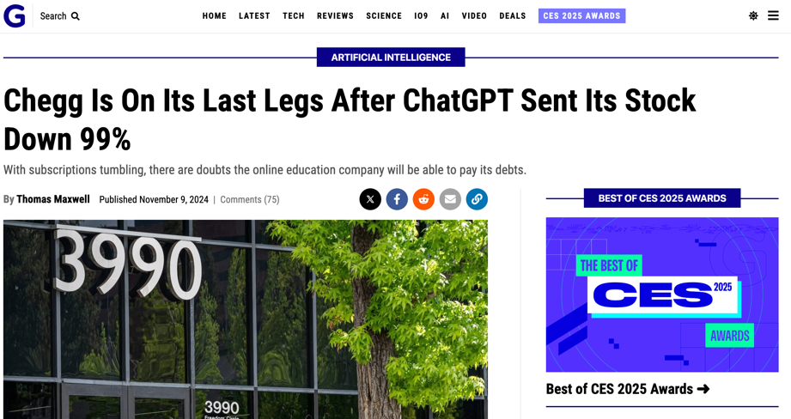
These Technologies Bring New Problems

Slide 28
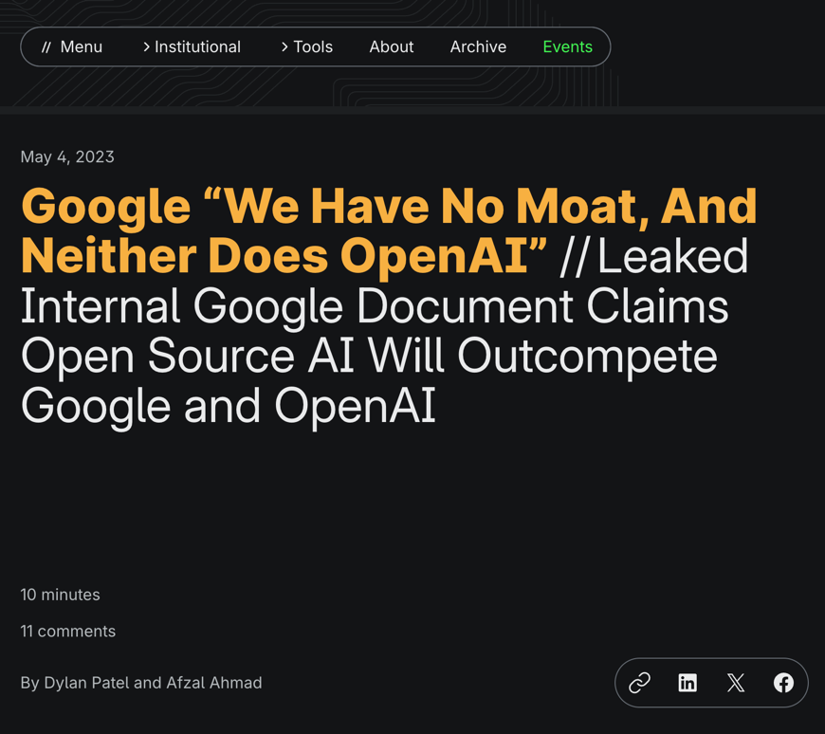
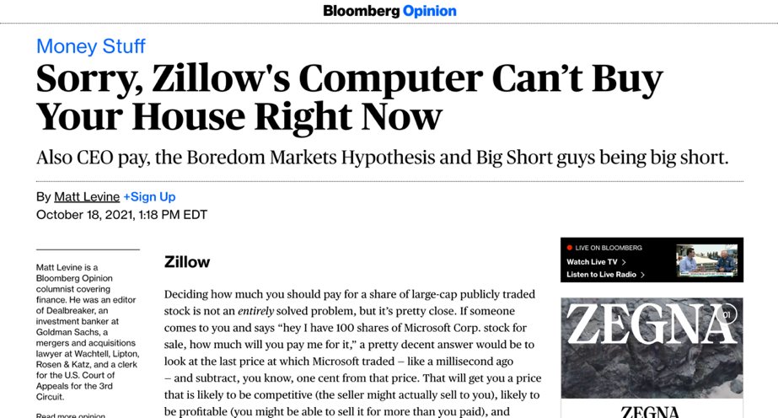
Business Process / Model Still Matters

Slide 29
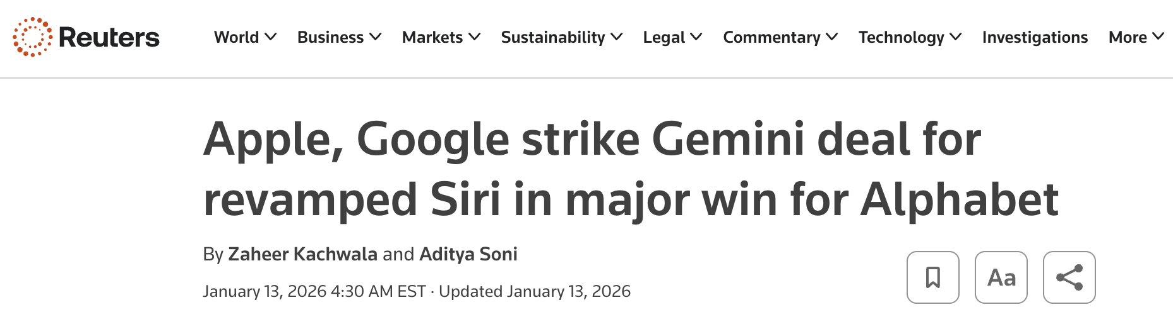

AI In the News

Slide 30
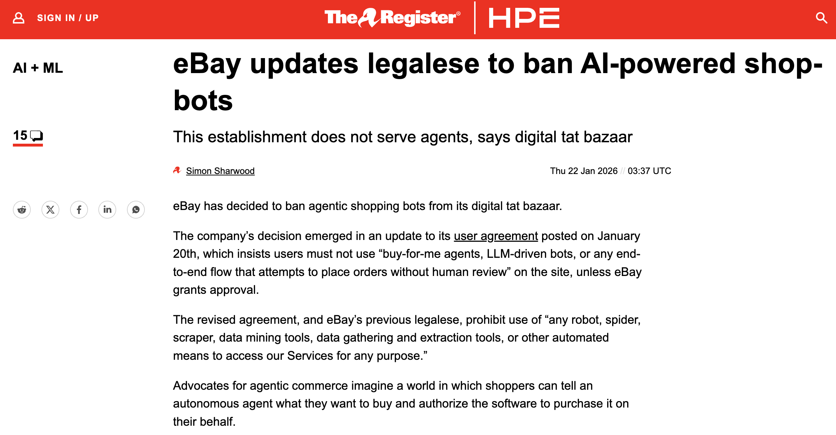
AI In the News

Slide 31
How It Works, Conceptually

Slide 32
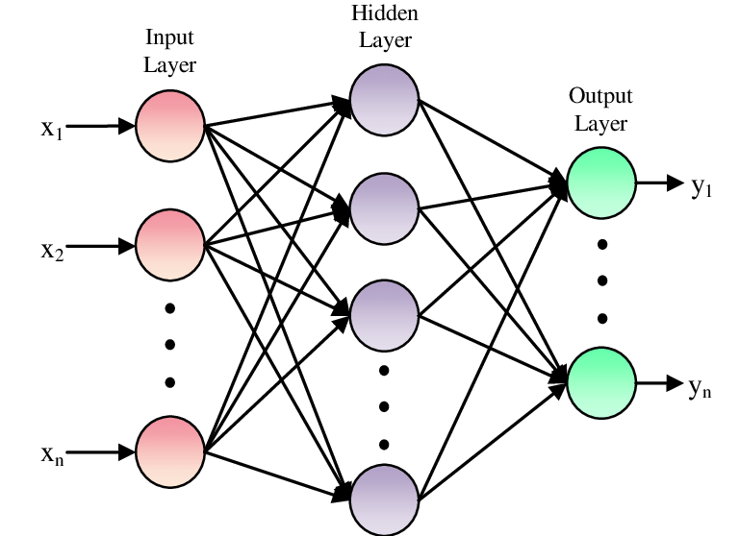
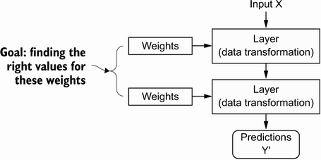
Model Parameters

Slide 33
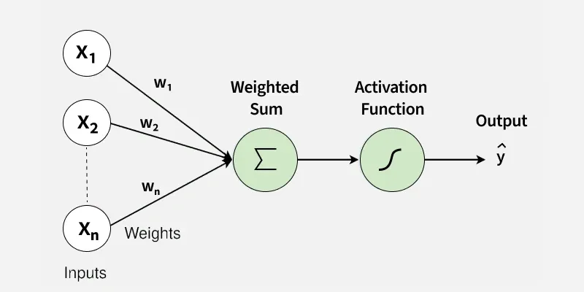
Model Parameters
Notes:
We define the network structure (layers / nodes / edges) and the activate functions (within each node). Our data, X and Y (inputs and labels) are given. Our goal is then to “learn” the remaining parameters, i.e., the w’s and b’s.

Slide 34
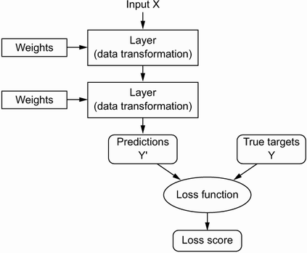
Loss Function (Error)
Notes:
How do we learn the parameters? We need a way to quantify how well we are doing. This is what the loss function is for; it informs our optimization about how ”optimal” our current set of parameter values is.

Slide 35
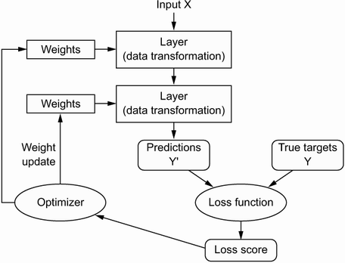
Optimization
Notes:
How do we implement the learning (optimization)? Gradient descent. We identify where we are on the loss curve, figure out a first derivative along all available dimensions (i.e., along all parameters), and proceed where the gradient is most negative (i.e., where the loss function progresses most rapidly toward zero. For this to work, we need to be able to figure out the gradient along each dimension (for each parameter) in a computationally efficient way (remember, some of the biggest models have thousands or millions of parameters!).

Slide 36
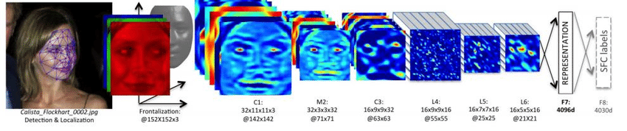
When to Learn Deeply (vs. Not)
COMPLEX RELATIONSHIPS
Complex, non-linear, interactive relationships and mappings; common use cases involve unstructured (high dimensional) data. Deep learning techniques remove the need for feature engineering, a daunting task.

Slide 37
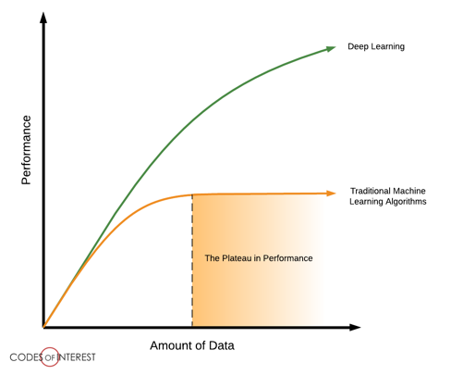
When to Learn Deeply (vs. Not)
LOTS OF DATA ON HAND
To be able to learn those complex mappings, typically requires many, many, many training examples.

Slide 38
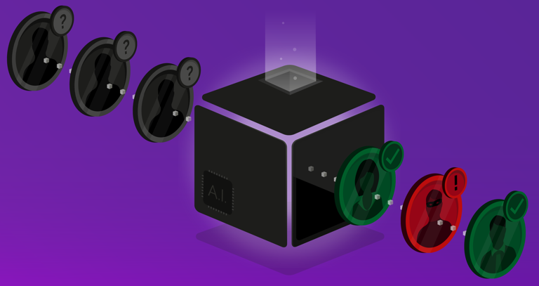
When to Learn Deeply (vs. Not)
LITTLE NEED FOR UNDERSTANDING
Although there have been advancements in explainable and interpretable AI, deep nets are notoriously “black box” algorithms.

Slide 39
Why Did Deep Learning Take Off?

Slide 40
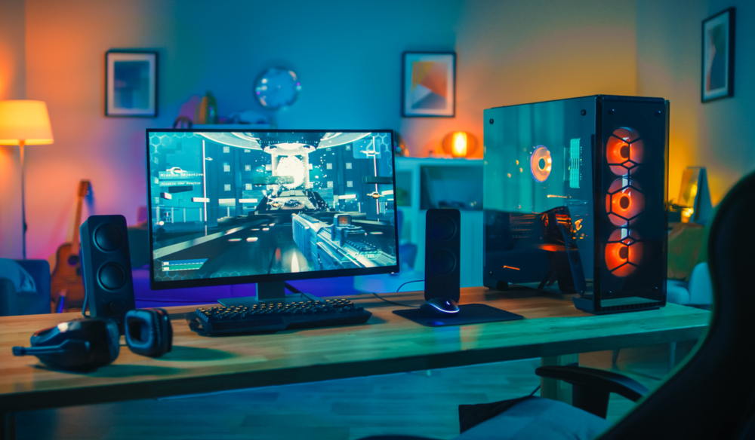
Video Games
Notes:
GPUs were developed to handle parallel processing capabilities needed for high end video game graphics. Turns out those same designs were useful for training a neural net (parallel computation, through vectorization of code). Basically, training a deep net involves performing a shitload of matrix multiplications. It’s better if we can do those calculations in parallel rather than sequentially. GPUs (and now TPUs) enable a ton of parallelization, speeding up the calculations.

Slide 41
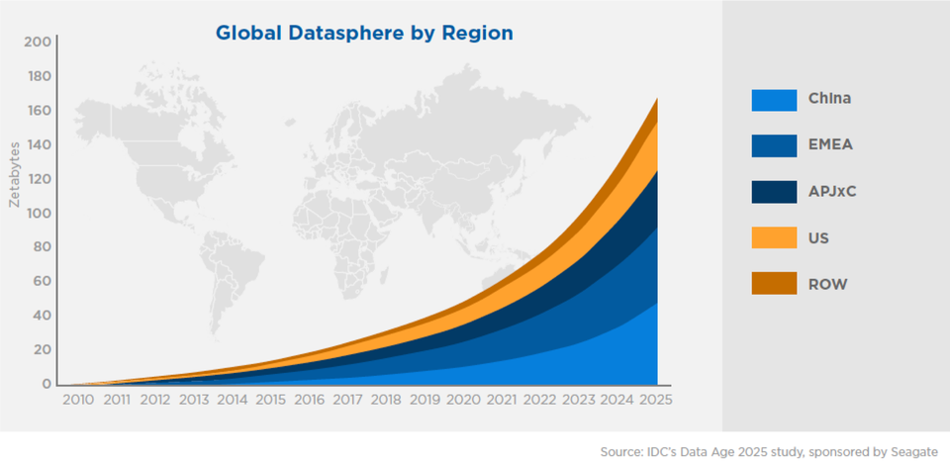
Data

Slide 42
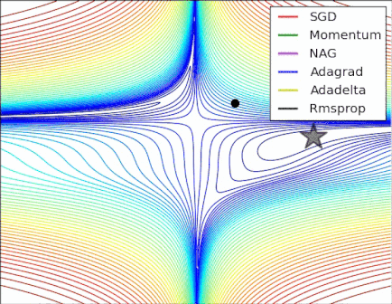
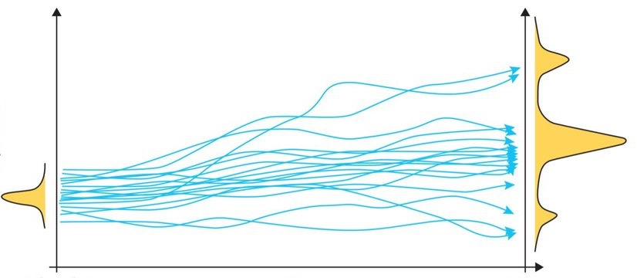
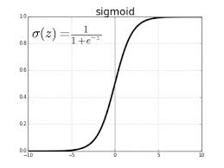
Algorithmic Improvements

Slide 43
Questions?

